Slide 1

Damage Detection & Classification
of Fruits Using Machine Learning Technique
Supervised by
Sadia Jahan
Lecturer
Department of CSE, City University
Presented by
SL. NO. | NAME | ID | BATCH | DEPT.
01 | Md. Emran Hasan | 152392002 | 39th | CSE
02 | Saiful Islam Sajon | 152392317 | 39th | CSE

Slide 2
Presentation Outline
Abstract
Machine Learning
Related Work
Research Challenges
Proposed Method
Experimental Analysis
Experimental Result
Future Works
Conclusion
References

Slide 3
Abstract
The food processing industry has been working with different kind of fruits. Most of the industries who are classifying the classes and the damages of fruit are manual. As a result of manual classification, it will become a challenging task for human as it is costly and time consuming. So, in this research work, we have proposed a method with a machine learning technique that classify various kinds of fruits and detect damage automatically. We have used seven machine learning algorithms for validating our proposed method and k-mean and graph-cut segmentation technique to detect damage on fruit image.

Slide 4

Machine learning
Logistic Regression (LR)
Linear Discriminant Analysis (LDA)
K-nearest neighbor (KNN)
Decision Tree Classifier (CART)
Random Forest Classifier (RF)
Gaussian Naive Bayes (NB)
Support Vector Machine (SVM)
Picture courtesy: https://pngio.com
Notes:
Classification And Regression Tree (CART)

Slide 5
Related Works
In 2018, Mureşan et. al. introduce a method for fruit recognition from images.
Contribution:
The Convolutional Neural Networks (CNN) gives better accuracy in different scenario.
Achieved accuracy between 91.91% - 95.41%
They introduced a high quality of dataset that includes different kind of fruits.
TensorFlow is used in order to implement the method.
Limitation:
This is a more time consuming process

Slide 6
Related Works(cont.)
In 2015 Bhange et. al. proposed a web based tool for pomegranate disease detection.
Contribution:
Image processing technique is used for disease detection.
k-means algorithm used for clustering and SVM for training and classification.
82% accuracy of identifying pomegranate disease.
Limitation:
Worked with a small dataset.
Worked with only one fruit.

Slide 7
Related Works(cont.)
In 2015 Awate et. al. proposed an efficient smart farming technique which will help for better yield and growth with less human efforts.
Contribution:
Artificial Neural Network (ANN) concept is used for pattern matching and classification of diseases.
OpenCV library is applied for implementation.
K-means clustering method is applied for image segmentation.
Achieved 90% accurate result.
Limitation:
Find the disease of fruit but not the damage.
Worked with only three fruits.

Slide 8

Research Challenges
Selecting Training and Testing dataset.
Extracting features
Marge extracted features
Train models
Detect Damage on fruit
Calculate the percentage of the damage
Picture courtesy: http://www.topsocialscoop.com
Notes:
Classification And Regression Tree (CART)

Slide 9
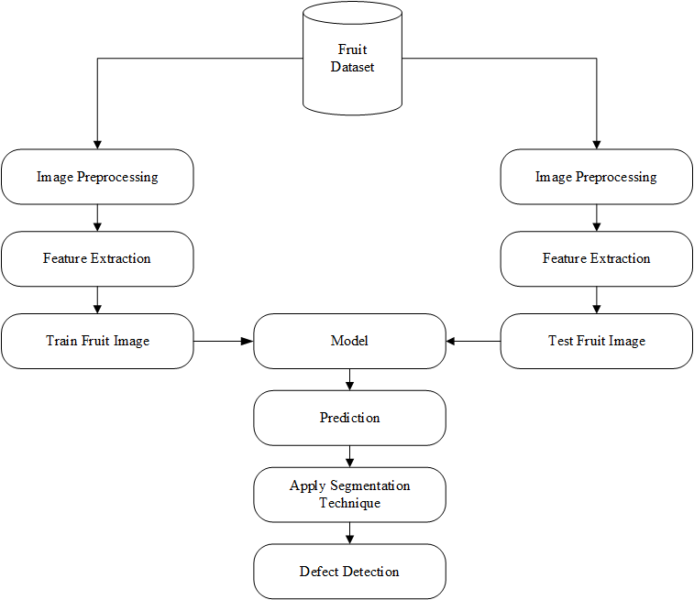
Proposed Method
Split the dataset into two part training and testing
Image Preprocessing
Extract feature
Train & Test Fruit images
Prediction (return predicted image with label)
Segment color
Detect damage with percentage
Figure 1: Proposed Method for Fruit Identification.

Slide 10
Experimental Analysis
Dataset Description
Table 01: Fruit Dataset
No. | Data Set | No. of Features | Names of Features | Working Instances | Training Instances | Testing Instances | Classes | Category
01 | Fruits-360 | 3 | Color, Shape, Texture | 8685 | 7185 | 1500 | 15 | Semi-Supervised

Slide 11
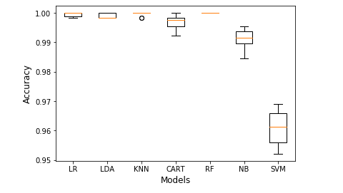
Experimental Analysis (Con.)
Machine Learning Algorithm Comparison
Figure 4: Accuracy for K-fold Cross Validation

Slide 12
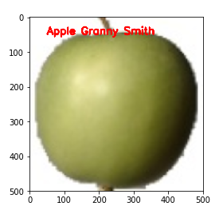
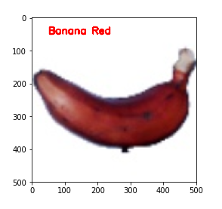
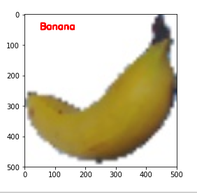
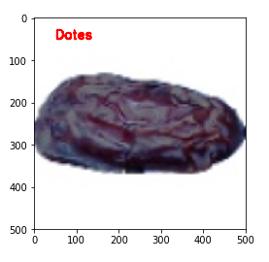
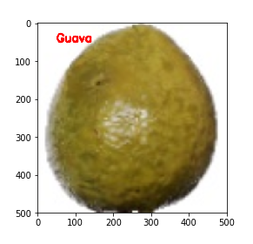
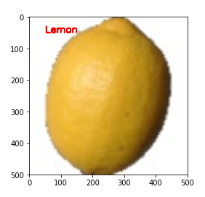
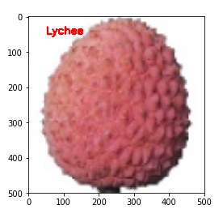
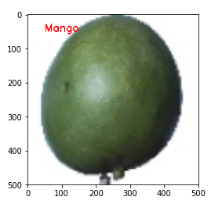
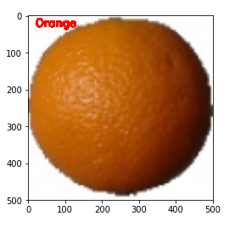
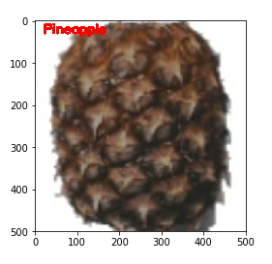
Experimental Result
Figure 5: Fruit Identification Results

Slide 13
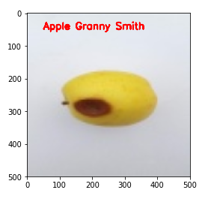
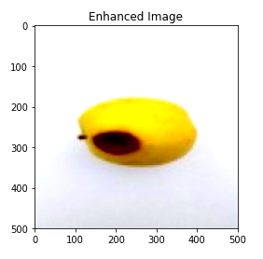
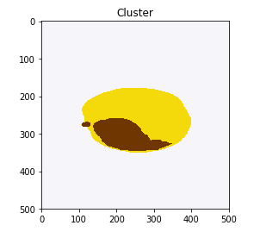
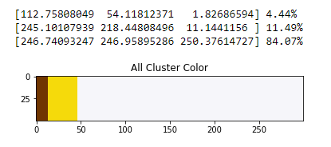
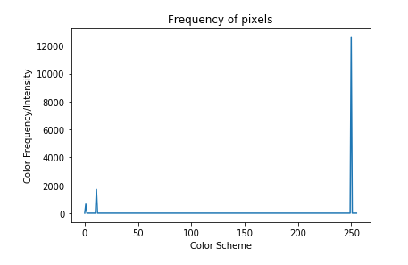
Experimental Result (Con.)
Figure 6: Damage Detection Result For K-means Clustering

Slide 14
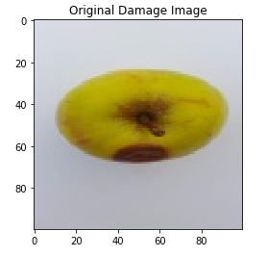
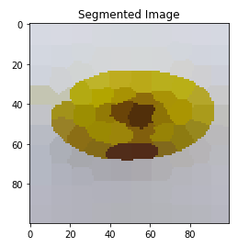
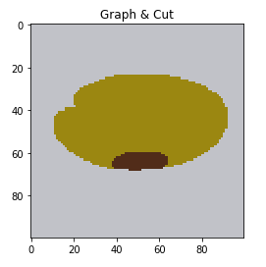
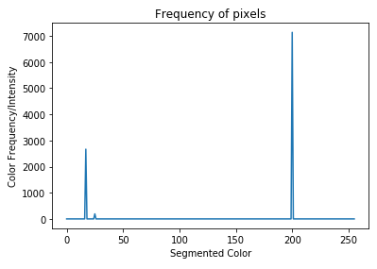
Experimental Result (Con.)
Figure 7.1: Graph-Cut Color Segmentation

Slide 15
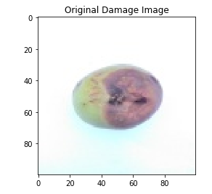
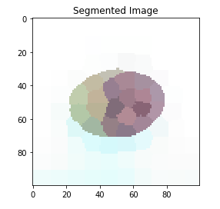
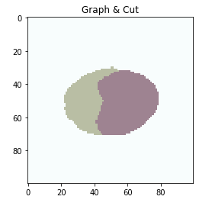
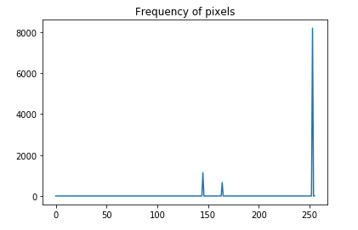
Experimental Result (Con.)
Figure 7.2: Graph-Cut Color Segmentation

Slide 16
Future Scope
In future. we will try to apply deep learning to detect exact damage on fruit.
We will work with real time data
We run our method in a high configure pc to train the full dataset of fruits-360

Slide 17
Conclusion
Machine learning technique is very effective to classify fruits.
In this research work we successfully identify different kind of fruit from 15 classes.
We achieved best accuracy.
Damage detection on fruit image is done by using two different unsupervised ML algorithm.
Percentage of damage is detected.

Slide 18
References
[1] Mureşan, Horea, and Mihai Oltean. "Fruit recognition from images using deep learning." Acta Universitatis Sapientiae, Informatica 10, no. 1 (2018): 26-42.
[2] Md. Imran Hosen, Tahsina Tabassum, Jesmin Akhter, Md. Imdadul Islam, “Detection of Fruits Defects Using Colour Segmentation Technique”, International Journal of Computer Science and Information Security (IJCSIS), Vol. 16, No. 6, June 2018.
[3] PL.Chithra , M.Henila, “Fruits Classification Using Image Processing Techniques”, International Journal of Computer Sciences and Engineering, Vol. 7(5), Mar 2019, E-ISSN: 2347-2693

Slide 19
References
[4] Saeideh Gorji Kandi, “Automatic Defect Detection and Grading of Single-Color Fruits Using HSV (Hue, Saturation, Value) Color Space”, Dec. 2010, Volume 4, No.7 (Serial No.32) Journal of Life Sciences, ISSN 1934-7391, USA.
[5] Mr.S V.Phakade, Miss. D’souza Flora, Miss. Halade Malashree, Miss. Joshi Rashmi, “Automatic Fruit Defect Detection Using HSV and RGB Color Space Model”, International Journal of Innovative Research in Computer Science & Technology (IJIRCST), ISSN: 2347- 5552, Volume-2, Issue-3, May-2014.
[6] Bhange, Manisha, and H. A. Hingoliwala. "Smart farming: Pomegranate disease detection using image processing." Procedia Computer Science 58 (2015): 280-288.

Slide 20
References
[7] Mohana S.H., Prabhakar C.J., and Praveen Kumar P.U , “Surface Defect Detection and Grading of Apples”, DOI: 03.AETS.2013.4.33, Association of Computer Electronics and Electrical Engineers, 2013
[8] Awate, Ashwini, Damini Deshmankar, Gayatri Amrutkar, Utkarsha Bagul, and Samadhan Sonavane. "Fruit disease detection using color, texture analysis and ANN." In 2015 International Conference on Green Computing and Internet of Things (ICGCIoT), pp. 970- 975. IEEE, 2015.
[9] Zalak R. Barot, Narendrasinh Limbad, “An Approach for Detection and Classification of Fruit Disease: A Survey”, International Journal of Science and Research (IJSR), ISSN (Online): 2319-7064.

Slide 21
References
[10] Sachin D. Khirade, A. B. Patil, “Plant Disease Detection Using Image Processing,” IEEE, International Conference on Computing Communication Control and Automation, Pune, pp 768-771, 2015
[11] Suhaili Beeran Kutty, Noor Ezan Abdullah, Dr. Hadzli Hashim, A’zraa Afhzan Ab Rahim, Aida Sulinda Kusim,Tuan Norjihan Tuan Yaakub, Puteri Nor Ashikin Megat Yunus, Mohd Fauzi Abd Rahman, “Classification of Watermelon Leaf Diseases Using Neural Network Analysis”, IEEE, Business Engineering and Industrial Applications Colloquium (BEIAC), Langkawi, pp 459 – 464, 2013
[12] Ms. Kiran R. Gavhale, Prof. Ujwalla Gawande, Mr. Kamal O. Hajari, “Unhealthy Region of Citrus Leaf Detection Using Image Processing Techniques”, IEEE, International Conference for Convergence of Technology, Pune, pp 1-6, 2014

Slide 22
References
[13] Monika Jhuria, Ashwani Kumar, Rushikesh Borse, “Image processing for smart farming: Detection of disease and fruitgrading”, IEEE, Second International Conference on Image Processing, Shimla, pp 521 – 526, 2013
[14] Fruits 360 Dataset on GitHub. https://github.com/Horea94/Fruit-Images-Dataset. last visited on 23.04.2019 =>1, 10
[15] Fruits 360 Dataset on Kaggle. https://www.kaggle.com/moltean/fruits. last visited on 23.04.2019 =>1, 10

Slide 23
Thank you , everyone!

